Slide 1
Machine Learning: Social Values, Data Efficiency, and Beyond Prediction
Travis Dick
Jan. 29, 2019

Slide 2
The Goal of my Research
Extend the theory and practice of machine learning to accommodate new requirements emerging from its use in real-world contexts.
Data Efficiency
Beyond Prediction
Social Values
?
?
?
?
?
?
Parameters
?
?
?
?
?
0.1
0.3
0.2
0.1
1.2
?

Slide 3
The Goal of My Research
Data Efficiency
?
?
?
There is disparity in the cost and availability of different types of data.
Need to make the best use of cheap and abundant data.
We focus on using unlabeled data in multi-class classification.
?
?
?
?
?
?
?
?
[Balcan, Dick, Mansour; AAAI 2017]
Beyond Prediction
Many learners learn to make predictions (e.g., medical diagnosis).
Important settings where learner’s output is not a prediction rule.
We’ll look at algorithm configuration / parameter tuning.
Parameters
[Balcan, Dick, Vitercik; FOCS 2018]
[Balcan, Dick, Vitercik; ICML 2018]
[Balcan, Dick, White; NeurIPS 2018]
Social Values
Learning systems now regularly interact with us.
Learning from personal data, making predictions about our behavior.
We want these systems to uphold our social values (e.g. privacy, fairness)
[Balcan, Dick, Liang, Mou, Zhang; ICML 2017]
[Balcan, Dick, Procaccia, Noothigattu; 2019]

Slide 4
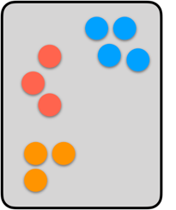
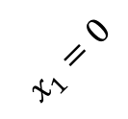
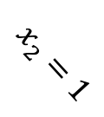
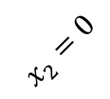
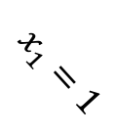
Outline
Beyond Prediction
Social Values
1. Online and Private Optimization of Piecewise Lipschitz Functions
Parameters
Joint with Nina Balcan and Ellen Vitercik
Clustering
Branch & Bound
My related work on algorithm configuration.
Joint with Nina Balcan, Colin White, and Ellen Vitercik
$$x_{1}=0$$
$$x_{1}=1$$
$$x_{2}=0$$
$$x_{2}=1$$
Social Values
2. Envy-free Classification
Joint with Nina Balcan, Ariel Procaccia, Ritesh Noothigattu

Slide 5
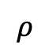
Part 1: Piecewise Lipschitz Optimization
Joint work with Nina Balcan and Ellen Vitercik [FOCS 2018]
value
Parameters
0.1
0.3
0.2
0.1
1.2
$$ρ$$

Slide 6
Motivation: Data-driven Algorithm Configuration
Classic Algorithm Design: Design algorithms for the worst-case.
Some domains have always-efficient optimal algorithms
Many important domains do not:
Clustering, subset selection, auction design, etc.
Data Driven Algorithm Design: Use learning and data to design/fine-tune algorithms
Suitable when we will repeatedly solve problems from the same domain.
We will see that piecewise Lipschitz optimization arises naturally in this setting.

Slide 7
Motivation: Data-driven Algorithm Configuration
Data Driven Algorithm Design Approach:
Design a large parameterized family of methods.
Different methods will work better for different settings.
Learn the best method/parameters for a specific application.
Prior Work is Mostly Empirical:
Artificial Intelligence: E.g. [Xu-Hutter-Hoos-LeytonBrown, JAIR 2008]
Computational Biology: E.g. [DeBlasio-Kececioglu, 2018]
Game Theory: E.g. [Likhodedov and Sandholm, 2004]
This Talk: Procedures with formal guarantees

Slide 8
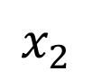
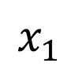
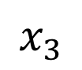
Data-Driven Algorithm Configuration
Problem instances from specific application.
$$x_{1}$$
$$x_{2}$$
$$x_{3}$$
…
Algorithm
Parameters
Output
0.1
0.3
0.2
0.1
1.2
Goal:
Automatically find the best parameters for a specific application domain.
Algorithm is run repeatedly, historic instances are training data.
Want provable guarantees for online and private settings.

Slide 9
Example: Greedy Knapsack Algorithm
[Gupta & Roughgarden ’16]
Problem Instance:
Given $n$ items
item $i$ has value $v_{i}$ and size $s_{i}$
a knapsack with capacity $K$
Find the most valuable subset of items that fits.
Algorithm: (Parameter $ρ≥0$)
Add items in decreasing order of $score_{ρ}\left(i\right)=v_{i}/s_{i}^{ρ}$.
Observation: For one instance, total value is piecewise constant in $ρ.$
value
$$ρ$$
Order of items fixed.

Slide 10
Online Piecewise Lipschitz Optimization
More generally: utility is a piecewise Lipschitz function of parameters.
Learning protocol:
For each round $t=1,…,T$:
Learner chooses point $ρ_{t}∈C⊂R^{d}$.
Adversary chooses piecewise $L$-Lipschitz function $u_{t}:C→R.$
Learner gets reward $u_{t}\left(ρ_{t}\right)$
Full information: Learner observes entire function $u_{t}$
Bandit information: Learner only observes the scalar $u_{t}(ρ_{t})$
Goal: Minimize regret $=\max_{ρ∈C} \sum_{t=1}^{T}{u_{t}(ρ)}−\sum_{t=1}^{T}{u_{t}\left(ρ_{t}\right)}.$
Meaningful Learning: Regret sublinear in $T$→ optimal average per round utility
Main Challenge: Utility functions have discontinuities – can’t use existing techniques.

Slide 11

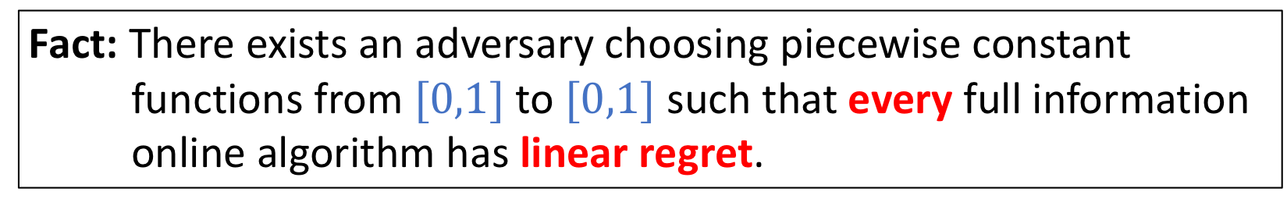
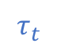
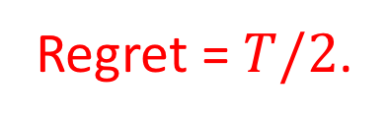


A Mean Adversary
Fact: There exists an adversary choosing piecewise constant functions from $[0,1]$ to $[0,1]$ such that every full information online algorithm has linear regret.
At round $t$, adversary chooses a threshold $τ_{t}$ and flips a coin to choose either
or
$$0$$
$$τ_{t}$$
$$1$$
$$0$$
$$τ_{t}$$
$$1$$
Every learner has expected utility of $½$ per round → expected total utility $T/2$.
Let $G_{t}=\{ρ∈\left[0,1\right] :u_{s}\left(ρ\right)=1$ for all $1≤s≤t\}$
Set $τ_{t}$ to be midpoint of $G_{t−1}$ → $\max_{T}{U_{T}\left(ρ\right)}=T$.
Regret = $T/2$.

Slide 12
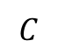

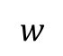
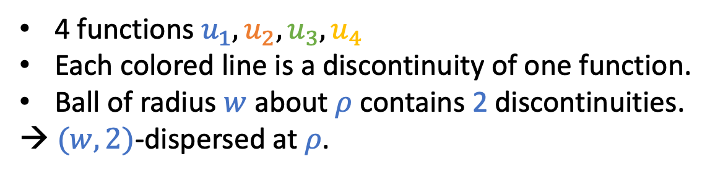
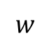
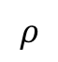
Dispersion
The mean adversary concentrated discontinuities near $ρ^{∗}$. Even very near points had low utility!
Def: Functions $u_{1}\left(⋅\right),…,u_{T}(⋅)$ are $\left(w,k\right)$-dispersed at point $ρ$ if the $ℓ_{2}$-ball $B\left(ρ,w\right)$ contains discontinuities for at most $k$ of $u_{1}…,u_{T}$.
$$C$$
4 functions $u_{1},u_{2},u_{3},u_{4}$
Each colored line is a discontinuity of one function.
Ball of radius $w$ about $ρ$ contains 2 discontinuities.
→ $(w,2)$-dispersed at $ρ$.
$$ρ$$
$$w$$
Functions will satisfy a range of dispersion parameters:
$$k$$
$$w$$

Slide 13
The Sum of Disperse Functions
Let $u_{1},…,u_{T}$ be PWL functions and plot their sum $\sum_{t}{u_{t}}$
Not disperse
Disperse
Many boundaries within interval
Few boundaries within interval

Slide 14
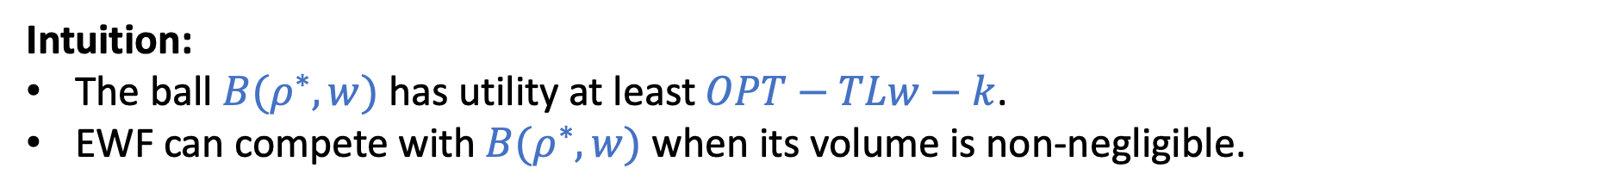
Full Information Regret Bounds
We analyze the classic Exponentially Weighted Forecaster [Cesa-Bianchi & Lugosi ’06]
Algorithm: (Parameter $λ>0$)
At round $t$, sample $ρ_{t}$ from $p_{t}\left(ρ\right)∝exp⁡(λ\sum_{s=1}^{t−1}{u_{s}(ρ)})$.
Theorem: If $u_{1},…,u_{T}:C→[0,1]$ are piecewise $L$-Lipschitz and $(w,k)$-dispersed at $ρ^{∗}$, EWF has regret $O\left(\sqrt{Td\log{\frac{1}{w}}}+TLw+k\right)$.
When is this a good bound? For $w=1/(L\sqrt{T})$ and $k=\tilde{O}(\sqrt{T})$ regret is $\tilde{O}(\sqrt{Td })$.
(We essentially achieve these values in all of our applications)
Intuition:
The ball $B(ρ^{∗},w)$ has utility at least $OPT−TLw−k$.
EWF can compete with $B(ρ^{∗},w)$ when its volume is non-negligible.
$$ρ^{∗}$$
Note: Don’t need to know $(w,k)$ to run algorithm.

Slide 15

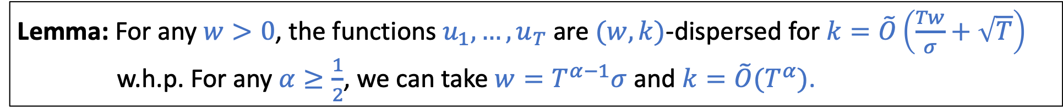

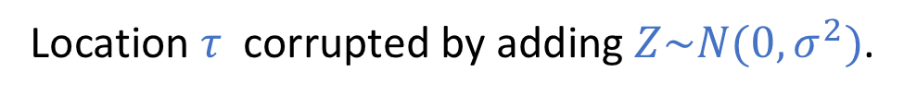
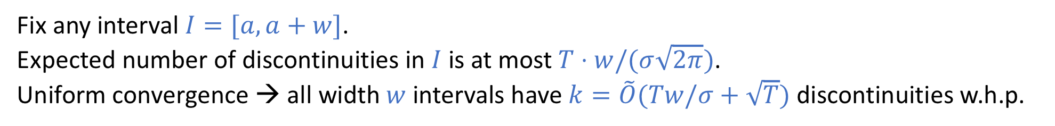
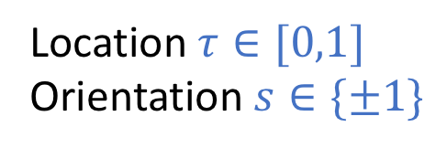
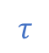
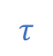
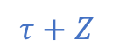


Smoothed Adversaries and Dispersion
Consider any adversary chooses threshold functions $u_{1},…,u_{T}:\left[0,1\right]→[0,1]$:
Location $τ∈[0,1]$
Orientation $s∈\{±1\}$
Location $τ$ corrupted by adding $Z\sim N(0,σ^{2})$.
$$0$$
$$τ$$
$$1$$
$$0$$
$$τ+Z$$
$$τ$$
$$1$$
Lemma: For any $w>0$, the functions $u_{1},…,u_{T}$ are $(w,k)$-dispersed for $k=\tilde{O}\left(\frac{Tw}{σ}+\sqrt{T}\right)$ w.h.p. For any $α≥\frac{1}{2}$, we can take $w=T^{α−1}σ$ and $k=\tilde{O}(T^{α})$.
Fix any interval $I=[a,a+w]$.
Expected number of discontinuities in $I$ is at most $T⋅w/(σ\sqrt{2π})$.
Uniform convergence → all width $w$ intervals have $k=\tilde{O}(Tw/σ+\sqrt{T})$ discontinuities w.h.p.

Slide 16
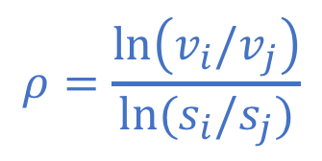
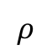
Smoothed Adversaries and Dispersion
More generally: adversary is unable to precisely pick some problem parameters (e.g. item values in knapsack).
Challenges:
Each utility function has multiple dependent discontinuities.
Distribution of discontinuity location depends on setting.
How do we generalize to multiple dimensions?
$$ρ=\frac{\ln\left(v_{i}/v_{j}\right)}{\ln{(s_{i}/s_{j})}}$$
value
$$ρ$$
Dispersion decouples problem-specific smoothness arguments from regret bounds and private utility guarantees.

Slide 17
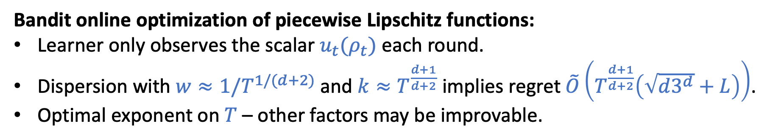
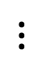
More Results from Dispersion
Bandit online optimization of piecewise Lipschitz functions:
Learner only observes the scalar $u_{t}(ρ_{t})$ each round.
Dispersion with $w≈1/T^{1/(d+2)}$ and $k≈T^{\frac{d+1}{d+2}}$ implies regret $\tilde{O}\left(T^{\frac{d+1}{d+2}}\left(\sqrt{d3^{d}}+L\right)\right)$.
Optimal exponent on $T$ – other factors may be improvable.
Verify Dispersion for Algorithm Configuration
Typically, smoothed adversaries choose dispersed functions.
Greedy algorithms for knapsack and max-weight independent set.
SDP rounding schemes for integer quadratic programs.
Differentially Private Optimization:
Goal: Approximately maximize the average with strong privacy guarantees for each individual.
$$⋮$$
No algorithm has non-trivial utility in the worst-case.
Matching upper and lower bounds from dispersion.

Slide 18
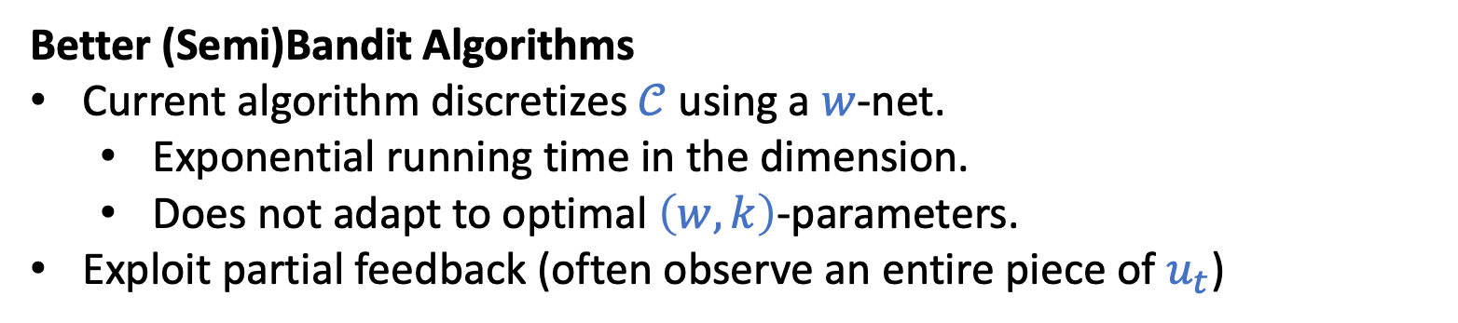
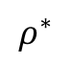
Future Work
Tidying Up and Easier Tools
Current definition is a bit complicated with many “gotchas”.
Working on getting crisp and intuitive definitions and better tools for verifying dispersion in practice.
Better (Semi)Bandit Algorithms
Current algorithm discretizes $𝒞$ using a $w$-net.
Exponential running time in the dimension.
Does not adapt to optimal $\left(w,k\right)$-parameters.
Exploit partial feedback (often observe an entire piece of $u_{t}$)
$$ρ^{∗}$$
More Applications
Derive dispersion for new algorithms (e.g., Initialization of Lloyd’s method)
Applications beyond algorithm configuration

Slide 19
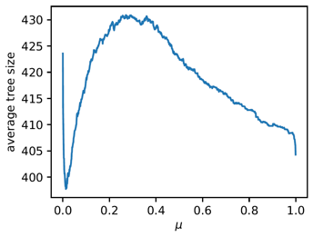
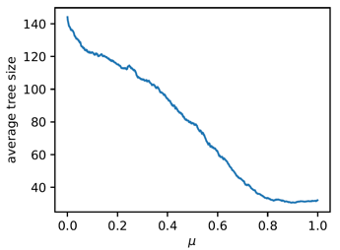
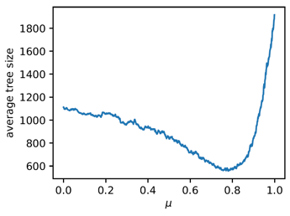
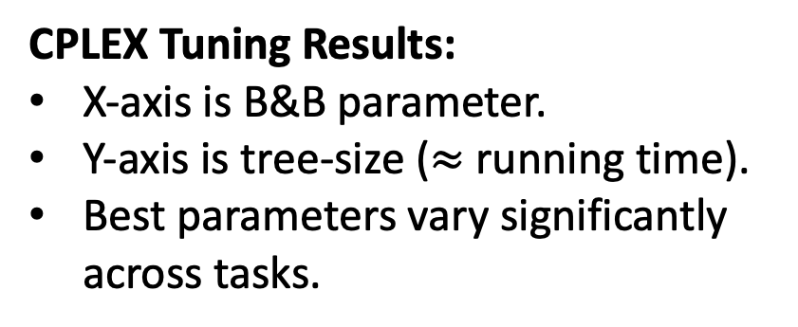
Other Algorithm Configuration Work
Branch & Bound for Mixed Integer Programming
[Balcan, Dick, Vitercik; ICML 2018]
Initialization Procedures for Center-Based Clustering
[Balcan, Dick, White; NeurIPS 2018]
Interpolating between Single, Complete, and Average Linkage
[Balcan, Dick, Lang; 2019]
[Balcan, Nagarajan, Vitercik, White; COLT 2017]
Uniform convergence guarantees in the i.i.d. setting (problems drawn from a distribution)
Large-scale experiments carried out on 256 vCPUs on AWS EC2.
E.g., for B&B we modify IBM’s CPLEX using callbacks to change the “variable selection policy” and implement our tuning algorithm.
CPLEX Tuning Results:
X-axis is B&B parameter.
Y-axis is tree-size ($≈$ running time).
Best parameters vary significantly across tasks.
Linear Separators
Clustering
CATS Arbitrary

Slide 20
Part 2: Envy-free Classification
Joint work with Nina Balcan, Ariel Procaccia, and Ritesh Noothigattu [Ongoing]
Social Values

Slide 21
Envy-freeness
Envy-freeness is the gold standard of fairness for fair division.
E.g.
cake cutting
chore assignment
Idea: Assignment is envy free if no one prefers the assignment of anyone else over their own.

Slide 22
Envy-Freeness in Machine Learning
Idea: A classifier is envy-free if no individual prefers the prediction/assignment of another.
Key Properties:
Provides fairness guarantees to individuals.
Group Fairness
Individual Fairness
It is suitable when there are many outcomes and heterogeneous preferences.
Advertisement Preferences
Job Listings
Being released on bail.
vs
Getting a loan.

Slide 23
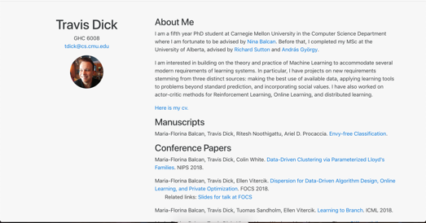
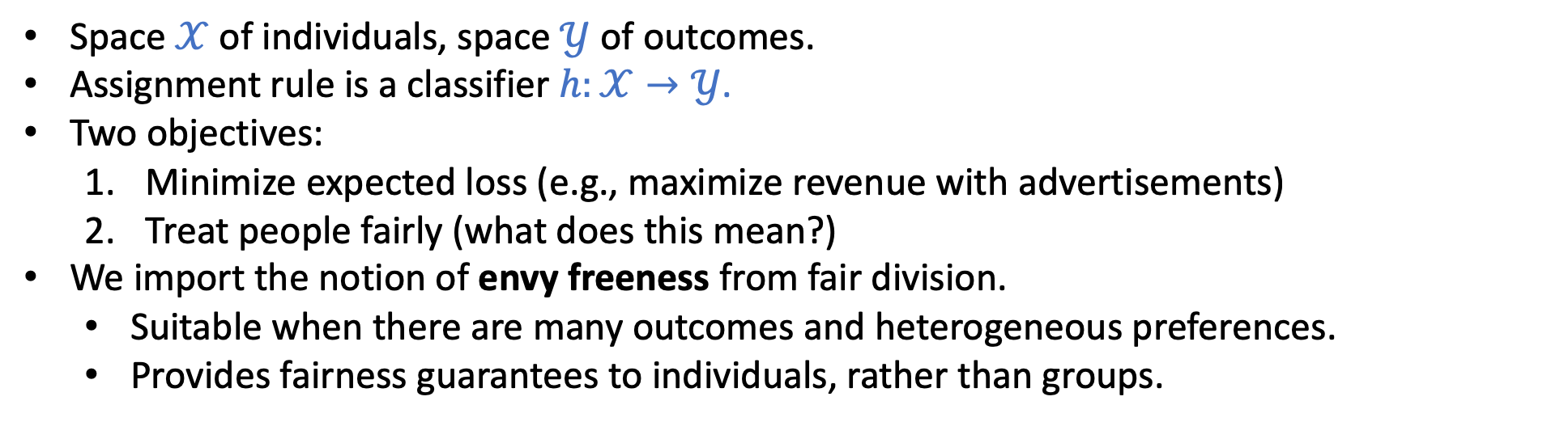
Problem Setting
We want to use ML to learn to assign outcomes to individuals.
For example, deciding which advertisements to show in order to maximize revenue.
Space $𝒳$ of individuals, space $𝒴$ of outcomes.
Assignment rule is a classifier $h:𝒳→𝒴$.
Two objectives:
Minimize expected loss (e.g., maximize revenue with advertisements)
Treat people fairly (what does this mean?)
We import the notion of envy freeness from fair division.
Suitable when there are many outcomes and heterogeneous preferences.
Provides fairness guarantees to individuals, rather than groups.

Slide 24

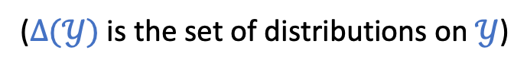
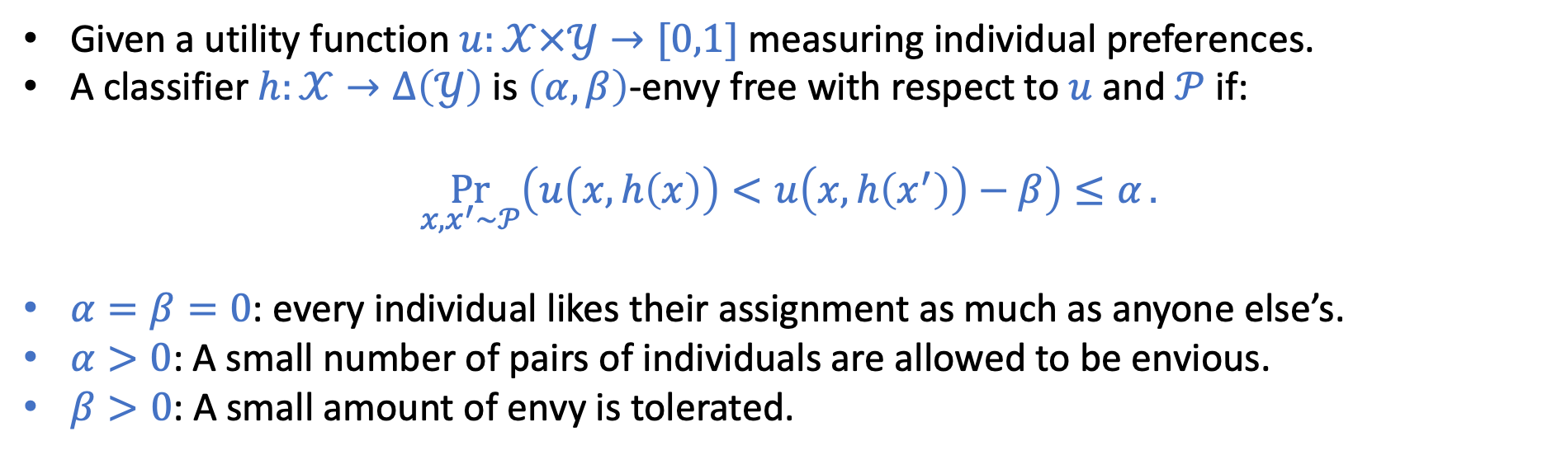
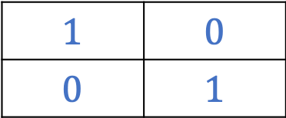
Envy-free Classifiers
($Δ(𝒴)$ is the set of distributions on $𝒴$)
Given a utility function $u:𝒳×𝒴→[0,1]$ measuring individual preferences.
A classifier $h:𝒳→Δ\left(𝒴\right)$ is $\left(α,β\right)$-envy free with respect to $u$ and $𝒫$ if:
$$\underset{x,x^{′}∼𝒫}{Pr}\left(u\left(x,h\left(x\right)\right)<u\left(x,h\left(x^{′}\right)\right)−β\right)≤α.$$
$α=β=0$: every individual likes their assignment as much as anyone else’s.
$α>0$: A small number of pairs of individuals are allowed to be envious.
$β>0$: A small amount of envy is tolerated.
Example: Two individuals and two outcomes
$$1$$ | $$0$$
$$0$$ | $$1$$
Utilities:
$(0,0)$-EF requires $h\left( , \right)≥h\left( , \right)$ and $h\left( , \right)≥h\left( , \right)$.

Slide 25
Randomized Classifiers
Envy-freeness is a very strong requirement on deterministic classifiers:
Lem: Every deterministic (0,0)-EF map is of the form $h\left(x\right)=argmax_{y∈Y^{′}}u(x,y)$ where $Y′$ is a subset of the classes $Y$ (breaking ties arbitrarily).
We consider randomized classifiers (that assign distributions to individuals) since they have a lot more freedom.
Better tradeoffs between fairness and accuracy.
Can construct examples where best randomized (0,0)-EF classifier has arbitrary multiplicative improvement over best deterministic (0,0)-EF classifier.

Slide 26
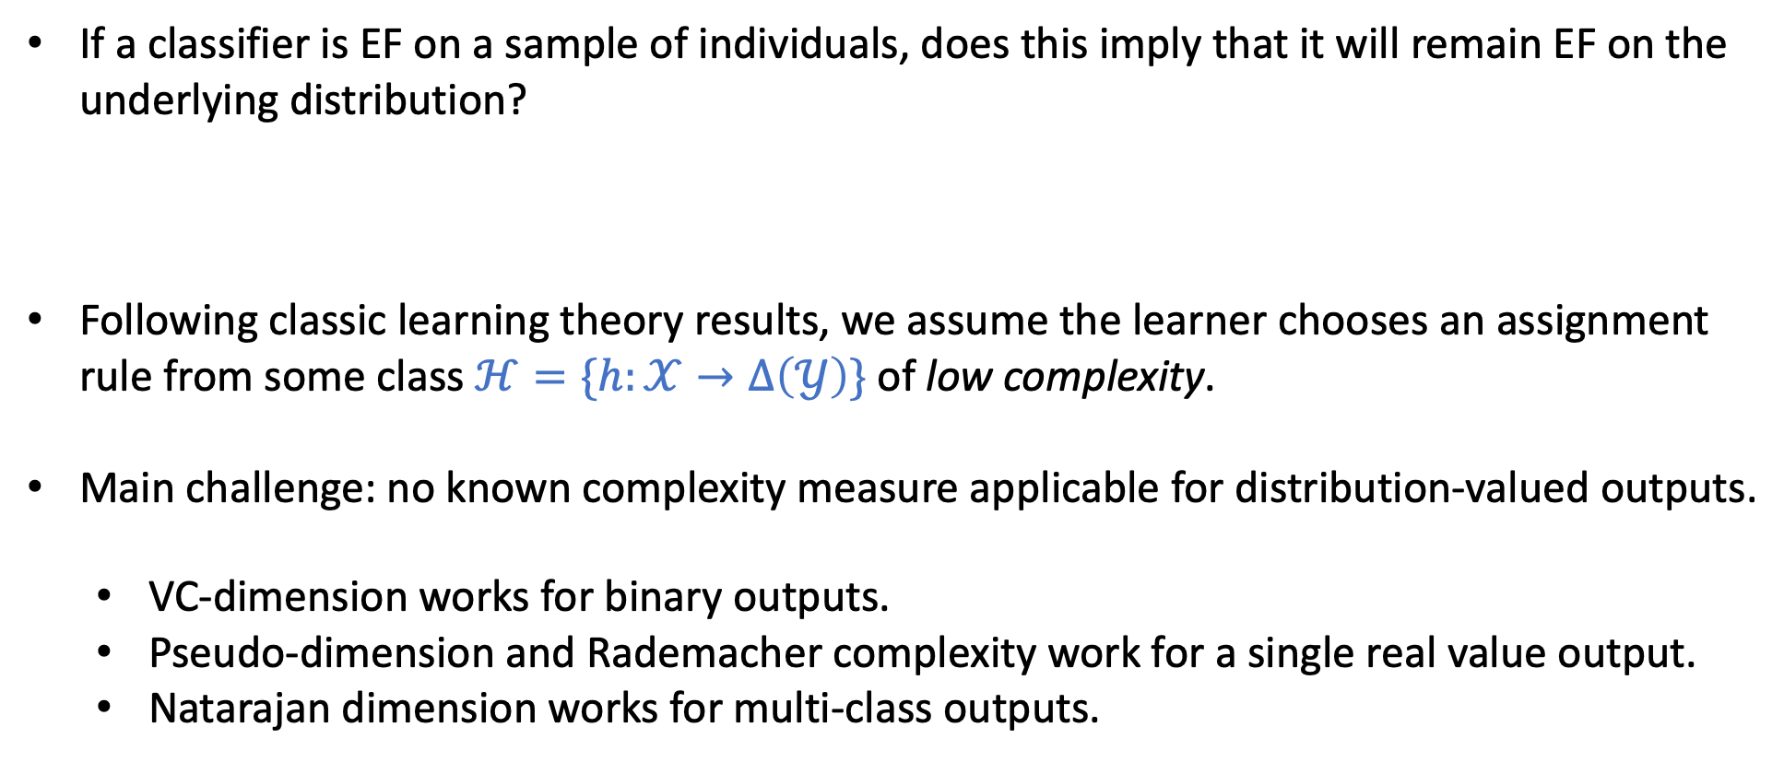
Main Question: Can we learn EF classifiers?
If a classifier is EF on a sample of individuals, does this imply that it will remain EF on the underlying distribution?
Following classic learning theory results, we assume the learner chooses an assignment rule from some class $ℋ=\{h:𝒳→Δ\left(𝒴\right)\}$ of low complexity.
Main challenge: no known complexity measure applicable for distribution-valued outputs.
VC-dimension works for binary outputs.
Pseudo-dimension and Rademacher complexity work for a single real value output.
Natarajan dimension works for multi-class outputs.

Slide 27
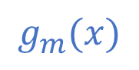
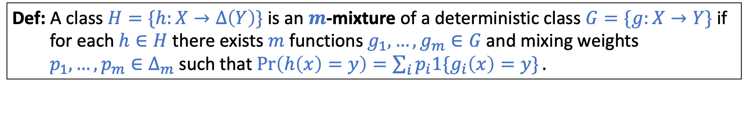
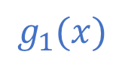
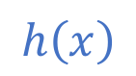
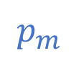
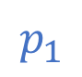
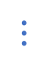
Random Mixtures of Deterministic Classifiers
No existing natural notion of complexity for distribution-valued outputs…
Idea: Many randomized classifiers can be expressed as mixtures of deterministic classifiers.
Def: A class $H=\{h:X→Δ\left(Y\right)\}$ is an $m$-mixture of a deterministic class $G=\{g:X→Y\}$ if for each $h∈H$ there exists $m$ functions $g_{1},…,g_{m}∈G$ and mixing weights $p_{1},…,p_{m}∈Δ_{m}$ such that $\operatorname{Pr}\left(h\left(x\right)=y\right)=\sum_{i}{p_{i}1\{g_{i}\left(x\right)=y\}}.$
$h$ randomly picks $g_{i}$ with probability $p_{i}$ and outputs its classification of $x$.
$$p_{1}$$
$$g_{1}(x)$$
$$h\left(x\right)$$
$$⋮$$
$$p_{m}$$
$$g_{m}(x)$$
If $G$ has low Natarajan dimension, and $H$ is an $m$-mixture of $G$, then we should expect envy-freeness to generalize for $H$.

Slide 28
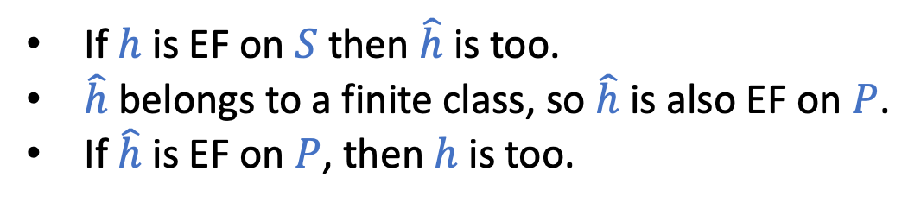
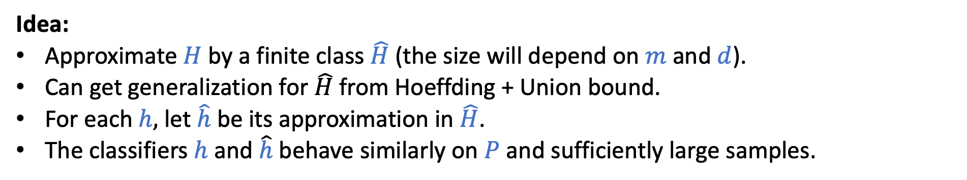





Envy-Freeness Generalizes for Random Mixtures
Thm: Let $H=\left\{h:X→Δ\left(Y\right)\right\}$ be an $m$-mixture of $G=\{g:X→Y\}$ and suppose the Natarajan dimension of $G$ is $d$. If $S=\{\left(x_{1},x_{1}^{′}\right),…,\left(x_{n},x_{n}^{′}\right)\}$ is an iid sample of $n=\tilde{O}\left(\frac{m^{2}d}{γ^{2}}\right)$ pairs from $P$, then w.h.p. every $h∈H$ that is $(α,β)$-EF on $S$ will be $(α+7γ,β+4γ)$-EF on $P.$
Idea:
Approximate $H$ by a finite class $\hat{H}$ (the size will depend on $m$ and $d$).
Can get generalization for $\hat{H}$ from Hoeffding + Union bound.
For each $h,$ let $\hat{h}$ be its approximation in $\hat{H}$.
The classifiers $h$ and $\hat{h}$ behave similarly on $P$ and sufficiently large samples.
$h$ on $S$
$\hat{h}$ on $S$
If $h$ is EF on $S$ then $\hat{h}$ is too.
$\hat{h}$ belongs to a finite class, so $\hat{h}$ is also EF on $P$.
If $\hat{h}$ is EF on $P$, then $h$ is too.
$h$ on $P$
$\hat{h}$ on $P$
EF parameters degrade along each edge.

Slide 29

Future Work
Improved Dependence on $m$ (number of classifiers mixed):
Current generalization bound is $\tilde{O}\left(\frac{dm^{2}}{γ^{2}}\right)$, but it should be $\tilde{O}\left(\frac{d}{γ^{2}}\right)$.
ERM Algorithms: Algorithms for efficiently finding low-envy low-loss classifiers.
New Fairness Notions:
I’m particularly interested in looking to the humanities and other disciplines where fairness has been important.

Slide 30

Other Work
Label-efficient multi-class learning.
[Balcan, Dick, Mansour; AAAI 2017]
Data
$1$^{st} Partition
2nd Partition
Partitioning schemes for communication-efficient distributed learning.
[Dick, Li, Pillutla, White, Balcan, Smola; AIStats 2017]
…
$k^{th}$ Partition
Differentially private $k$-means and $k$-median clustering
[Balcan, Dick, Liang, Mou, Zhang; ICML 2017]
Differentially private covariance estimation
$$v_{t}^{∗}$$
[Amin, Dick, Kulesza, Medina, Vassilvitskii; 2018]

Slide 31
Thanks!

Slide 32


Differentially Private Optimization
Goal: Given a collection of PWL functions $𝒮=\{u_{1},…,u_{T}:𝒞→ℝ\}$, maximize $\frac{1}{T}\sum_{t=1}^{T}{u_{t}(ρ)}$.
Differential Privacy:
Suppose each function $u_{t}$ encodes information about one individual.
Can we approximately optimize the mean while preserving $ε$-DP for each function?
(i.e., sets of functions $𝒮$ and $𝒮^{′}$ are neighboring if they differ on one function).
Constraint: $𝒜$ is $(ε,δ)$-DP if for all neighboring $𝒮$ and $𝒮′$ and any set $𝒪⊂𝒞$, we have
$$\operatorname{Pr}\left(𝒜\left(𝒮\right)∈𝒪\right)≤e^{ε}\operatorname{Pr}\left(𝒜\left(𝒮^{′}\right)∈𝒪\right)+δ$$
Example: Voting on thermostat settings
Travis
Ellen
Nina
desire
desire
…
desire
temperature
temperature
temperature

Slide 33



Differentially Private Optimization
Lemma: For every $T,ε,α>0$ and every $ε$-DP optimizer $𝒜$, there exists a set of functions $𝒮=\{u_{1},…,u_{T}:\left[0,1\right]→\left[0,1\right]\}$ so that $\frac{1}{T}∑u_{t}\left(ρ^{∗}\right)=1$ but w.p. $≥1−α$, $\frac{1}{T}∑u_{t}\left(𝒜\left(𝒮\right)\right)=0$.
Idea:
Every $ε$-DP optimizer must randomize its output.
Using PWL functions, we can make the optimal set arbitrarily small.
The odds that $𝒜$ hits that optimal region must be small.
(To formalize this idea, we can use a simple packing argument).
E.g. $T$ copies of:
Theorem: If the functions $u_{1},…, u_{T}:𝒞→[0,1]$ are piecewise $L$-Lipschitz and $(w,k)$-dispersed at the maximizer, then the suboptimality of the exponential mechanism is at most
$$\tilde{O}\left(\frac{1}{Tε}d\log{\frac{1}{w}}+Lw+\frac{k}{T}\right).$$
We also have a nearly matching lower bound.
When is this a good bound? For $w=1/(L\sqrt{T})$ and $k=\tilde{O}(\sqrt{T})$ suboptimality is $\tilde{O}(\frac{d}{Tε}+\frac{1}{\sqrt{T}})$.
*Note: Dispersion is only required for utility!

Slide 34


Warmup Generalization Result
Lem: Let $ℋ=\{h:X→Δ\left(Y\right)\}$ be finite. If $\left(x_{1},x_{1}^{′}\right),…,\left(x_{n},x_{n}^{′}\right)$ is an i.i.d. sample of pairs from $P^{2}$ of size $n=O\left(\frac{\log{(|H|/δ)}}{γ^{2}}\right)$, then w.p. $≥1−δ$ every $h$ in $ℋ$ that is $(α,β)$-EF on the sample is $(α+γ,β)$-EF on $𝒫$.
Idea:
Use Hoeffding’s inequality to get convergence for an appropriate “fairness loss” for each classifier.
Union bound over the finite set.
For infinite $|ℋ|$, should expect to replace $\log{|ℋ|}$ by some complexity measure.

Slide 35







Data Driven Clustering
[Balcan, Dick, White, NeurIPS 2018]
Goal: Given example clustering instances together with target clustering, find algorithm that has the best agreement.
Algorithm Outline:
Choose $k$ initial centers.
Perform local search to improve clustering.
E.g., Lloyd’s method (or $k$-means clustering)
Initialization is very important!
We choose initial centers randomly according to $d^{α}$-sampling.
$α=0$: random initialization
$α=2$: $k$-means++
$α=∞$: farthest first
What is the best value of $α$?

Slide 36

Data Driven Clustering
Efficient Tuning on Sample:
Efficient algorithm for finding parameters on sample with best agreement to targets.
“Algorithmically feasible to tune parameters on sample.”
Generalization Guarantee:
Analyze the intrinsic complexity of $(α,β)$-Lloyds
Show that need only roughly $\tilde{O}\left(\frac{k\log{n}}{ε^{2}}\right)$ clustering instances to ensure empirical cost for all parameters within $ε$ of expected cost.
“Parameters tuned on the sample will work well for new instances!”
Experiments: Evaluate $(α,β)$-Lloyds family on real and synthetic data.
CIFAR-10
MNIST
Mixture of Gaussians
CNAE-9

Slide 37


Highlights of Statistical Algorithm Configuration Projects
i.i.d. sampled problems
$$x_{1},x_{2},…,x_{T}$$
Application-Specific
Distribution
Algorithm Parameters
Algorithm Designer
How can I use the set of samples to find parameters that are best for my application domain?
Here, we have a utility $u(x,ρ)$ measuring quality of parameters $ρ$ for instance $x.$
Want to find the parameters $ρ^{∗}$ that maximize $𝔼_{x}\left[u\left(x,ρ\right)\right].$

Slide 38








Data Driven Branch and Bound for Mixed Integer Programs
[Balcan, Dick, Vitercik, ICML 2018]
Mixed Integer Programs:
Given $A,b,c,I$:
$$\max{c^{⊤}x}$$
s.t.
$Ax≤b$
$x_{i}∈\{0,1\}$ for $i∈I$
Branch and Bound:
$$x_{1}=0$$
$$x_{1}=1$$
Most popular solution method for MIPs.
Recursively partitions solution space.
Each node fixes some integral variable to be 0 or 1.
Algorithm carefully avoids exploring some subtrees.
$$x_{2}=0$$
$$x_{2}=1$$
One Significant Question: How do you decide which variable to branch on in each node?
Goal: solve the MIP with the smallest tree ($≈$ shortest running time)
Many proposed heuristic rules.
No theory or rule of thumb for which rule works the best.
CPLEX manual: “You may need to experiment.”

Slide 39
Data Driven Branch and Bound for Mixed Integer Programs
Our Results:
[Balcan, Dick, Vitercik, ICML 2018]
We consider a family of variable selection policies that interpolates between well-known and effective heuristics.
We analyze the intrinsic complexity of the class, guaranteeing uniform convergence of the average utilities for all algorithms from the family.
Provide algorithms for finding the optimal algorithm from the class for a sample (exponential worst-case running time, but in practice they run quite quickly).
Carried out large-scale experiments tuning the variable selection policy of IBM’s CPLEX.
Use callbacks to modify variable selection rule.
Experiments carried out on a cluster of 256 AWS vCPUs.
Linear Separators
Clustering
CATS Arbitrary

